Slide 1
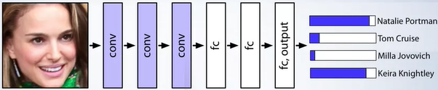
LX CNNs and RNNs
Z. Gu 2021
Acknowledgement: some contents taken from UC Berkeley CS231n cs231n.github.io/

Slide 2
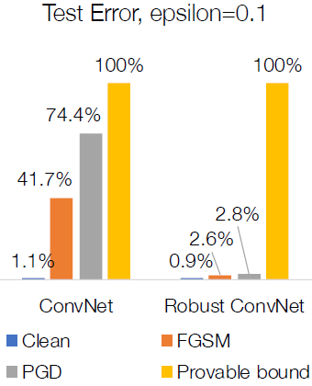
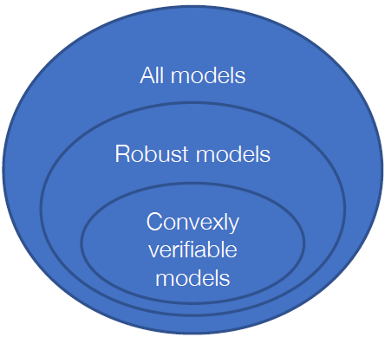
Provably Robust Training w. Convex Relaxation
Let’s use the convex bounds to see what level of adversarial performance we can guarantee for the robust model
Test errors have provable bound of 100%, i.e., we can make no guarantees at all for this testset, even for the robust model
Insight: models that can be (convexly) verified to be robust are a small subset of the actually robust models. Convex bounds are typically very loose unless the model was built with them in mind
Notes:
(in
this case, interval-bound-based
approach) Convex Methods for Certifying Robustness

Slide 3
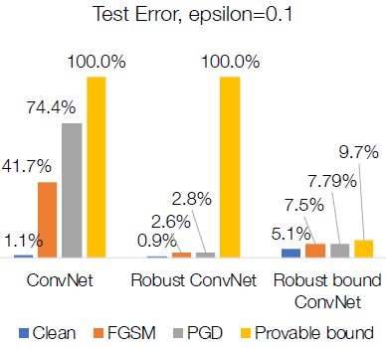
Training Provably Robust Models
Convex bounds (e.g., recall Interval-based Bounds) are differentiable functions of network parameters
Can train networks to minimize these bounds directly
Recent work shows that interval bounds often outperform more complex strategies [Mirman et al, 2018, Gowal et al., 2018]

Slide 4
Outline
CNN Convolution layers
Pooling and fully connected layers
CNN case studies
CNN on Embedded Systems
RNNs
Notes:
Safety plan
The safety plan gives an overview of how you are going to achieve a safe system. A few of the major elements include:
what system is under consideration
the goal of the project
what steps will be taken to ensure safety
the roles and personnel involved in the project
the project timeline

Slide 5

Classic Computer Vision
Most “classic” (non-ML) CV algorithms are implemented in the OpenCV library, including
Core Operations:
basic operations on image like pixel editing, geometric transformations, code optimization, some mathematical tools etc.
Image Processing
Thresholding, smoothing, edge detection, Hough Line Transform…
Feature Detection and Description
HOG, SIFT, SURF, BRIEF, ORB…
Video analysis
Object tracking w. optical flow
Camera Calibration and 3D Reconstruction
They are simple, fast and reliable (e.g., for lane detection), and are often used in conjunction w. complex ML/DL algorithms, which may be sometimes unreliable and unpredictable.
Notes:
https://docs.opencv.org/trunk/d6/d00/tutorial_py_root.html

Slide 6

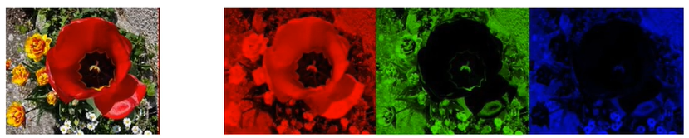
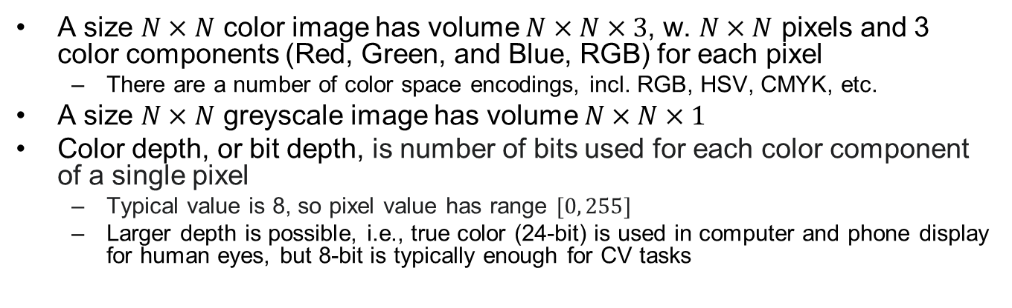
Input Image Encoding
A size $N×N$ color image has volume $N×N×3$, w. $N×N$ pixels and 3 color components (Red, Green, and Blue, RGB) for each pixel
There are a number of color space encodings, incl. RGB, HSV, CMYK, etc.
A size $N×N$ greyscale image has volume $N×N×1$
Color depth, or bit depth, is number of bits used for each color component of a single pixel
Typical value is 8, so pixel value has range $[0, 255]$
Larger depth is possible, i.e., true color (24-bit) is used in computer and phone display for human eyes, but 8-bit is typically enough for CV tasks
=
Notes:
Right: a $4×4$ pixels color image w. volume $4×4×3$, w.

Slide 7
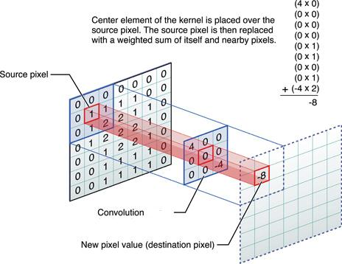


Filters/Kernels in Computer Vision
Convolution operation: we slide (convolve) each filter across the width and height of the input volume and compute dot products between the entries of the filter (kernel) and the input at any position. As we slide the filter over the width and height of the input volume we will produce a 2-dimensional activation map that gives the responses of that filter at every spatial position.
dot product operation: elementwise multiplication of a filter w. corresponding input values, then summing them to generate one output value
Used to extract features for downstream tasks (classification or regression)
Notes:
Convolution of a filter/kernel $w$ w. size $2a×2b$ w. a 2D image $f(x,y)$ generates another filtered 2D image $g(x,y)$, by elementwise multiplying corresponding elements then summing them:
of w. an input image/volume generates another filtered output volume, by Fig shows convolution operation of $3×3$ filter w. a greyscale image patch produces an output $−8$
$$g\left(x,y\right)=w∗f\left(x,y\right)=\sum_{dx=−a}^{a}{\sum_{dy=−b}^{b}{w\left(dx,dy\right)f\left(x+dx,y+dy\right)}}$$

Slide 8
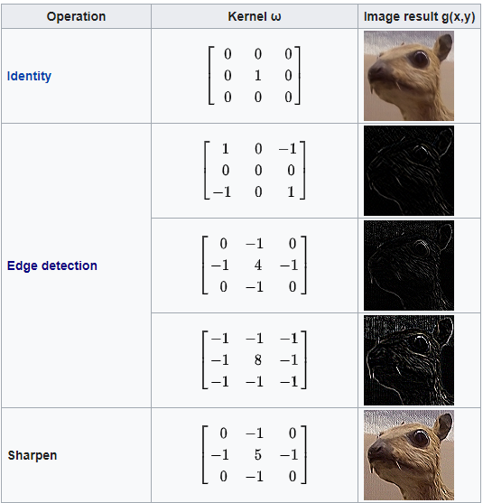
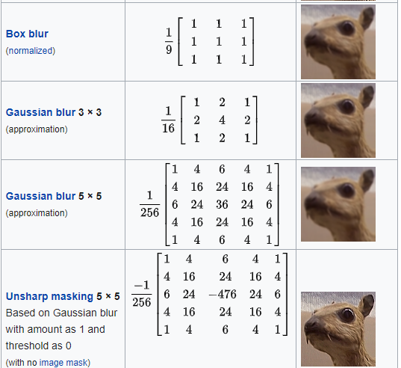
Effects of Convolution w. Common Filters
These filters were designed, or “hand-crafted”, by CV researchers. They extract features used by downstream tasks such as classification, image segmentation, etc.

Slide 9

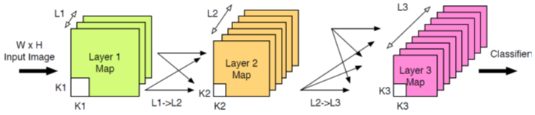
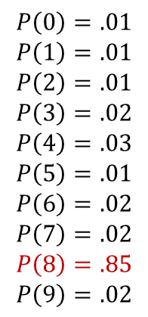
Convolutional Neural Networks (CNN)
$$P\left(0\right)=.01$$
$$P\left(1\right)=.01$$
$$P\left(2\right)=.01$$
$$P\left(3\right)=.02$$
$$P\left(4\right)=.03$$
$$P\left(5\right)=.01$$
$$P\left(6\right)=.02$$
$$P\left(7\right)=.02$$
$$P\left(8\right)=.85$$
$$P\left(9\right)=.02$$
Feature
Extraction
Classifier
(e.g., SoftMax)
A CNN (also called ConvNet) is a sequence of Convolutional (CONV) Layers, Pooling (POOL) Layers and non-linear activation functions for feature extraction, followed by one or more Fully-Connected (FC) Layers for classification based on the extracted features
Difference from classic CV: learn custom filters in CONV layers from data by supervised learning, instead of using hand-crafted filters
Notes:
A CNN (also called ConvNet) Combination of convolution (CONV), pooling, and rectification stages

Slide 10
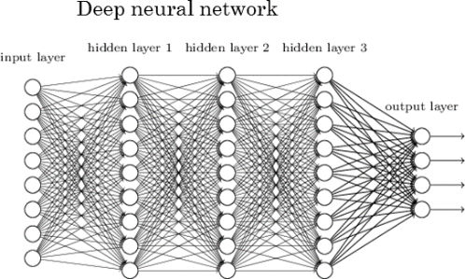

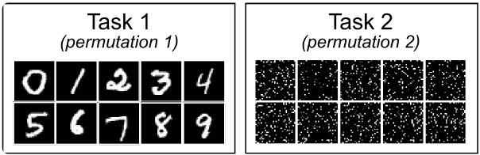
Fully-Connected NN vs. CNN
In a CNN, only the last few (typically <=3) layer(s) are Fully-Connected
CONV layers can handle images of arbitrary size (but not the last MLP layer(s))
Not permutation invariance
Can recognize geometry/locality of input
Translation invariance
Fewer params than MLP (less prune to overfitting)
In a FCNN:
Cannot alter input image size
Permutation invariance
Cannot recognize geometry/locality of input, hence not useful for image recognition
Below two images, with same set of pixels but different permutations, will generate the exact same output in an MLP
Num. params can grow very large

Slide 11

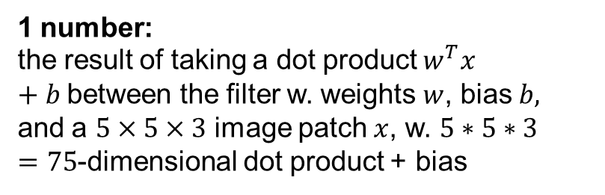
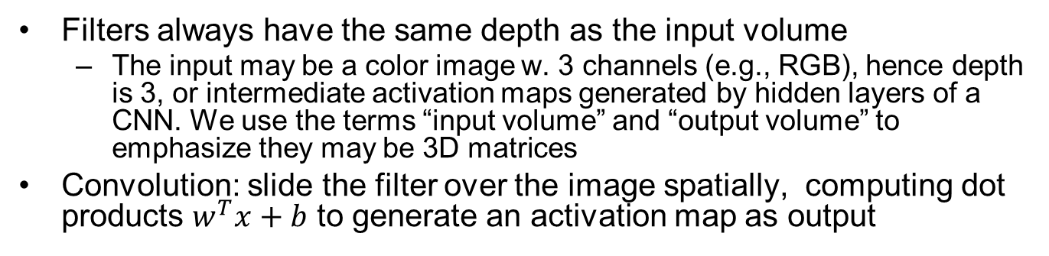
Convolution Operation
Filters always have the same depth as the input volume
The input may be a color image w. 3 channels (e.g., RGB), hence depth is 3, or intermediate activation maps generated by hidden layers of a CNN. We use the terms “input volume” and “output volume” to emphasize they may be 3D matrices
Convolution: slide the filter over the image spatially, computing dot products $w^{T}x+b$ to generate an activation map as output
32x32x3 input 5x5x3 filter
32
1 number:
the result of taking a dot product $w^{T}x+b$between the filter w. weights $w$, bias $b,$ and a $5×5×3$ image patch $x$, w. $5∗5∗3=75$-dimensional dot product + bias
32
3

Slide 12
32x32x3 input
5x5x3 filter
32
One (blue) filter generates one 2D activation map as output
28
convolve (slide) over all spatial locations
32
28
32x32x3 input 5x5x3 filter
Multiple (blue and green) filters generate multiple (blue and green) 2D activation maps, stacked along the depth dimension to produce the 3D output volume
3
1
32
28
convolve (slide) over all spatial locations
32
28
3
1

Slide 13
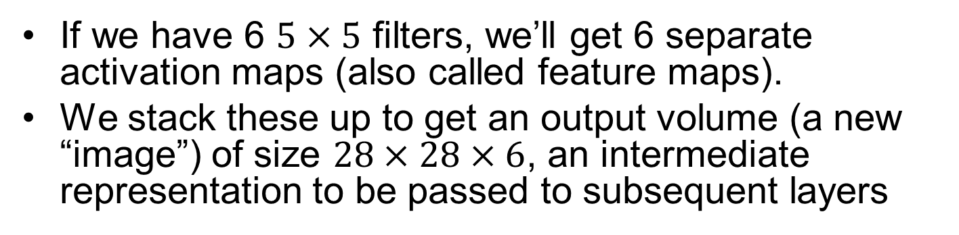
Stacked Activation Maps
If we have 6 $5×5$ filters, we’ll get 6 separate activation maps (also called feature maps).
We stack these up to get an output volume (a new “image”) of size $28×28×6$, an intermediate representation to be passed to subsequent layers
activation maps
32
28
Convolution Layer w.
6 5x5 filters
32
28
3
6

Slide 14
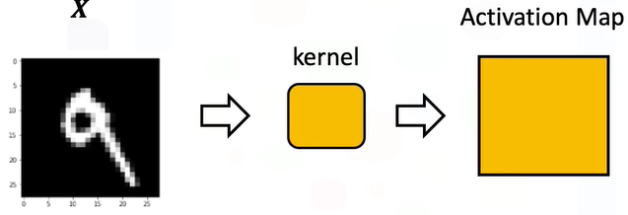
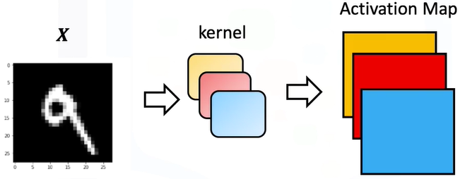
Activation Maps Illustration
1 filter/kernel, 1 output activation map
3 filters/kernels, 3 output activation maps

Slide 15
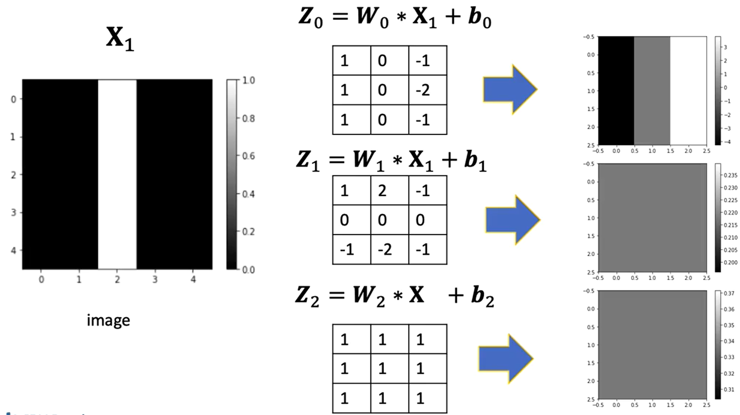
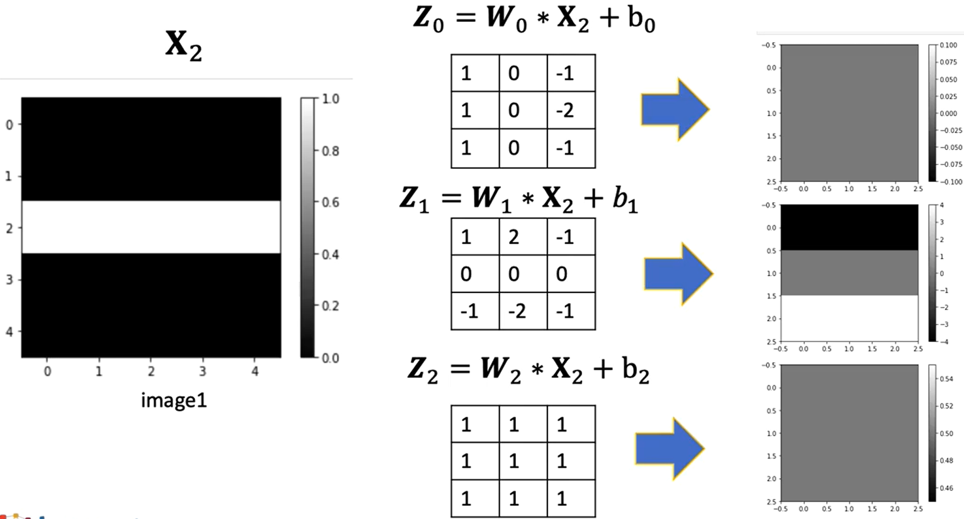
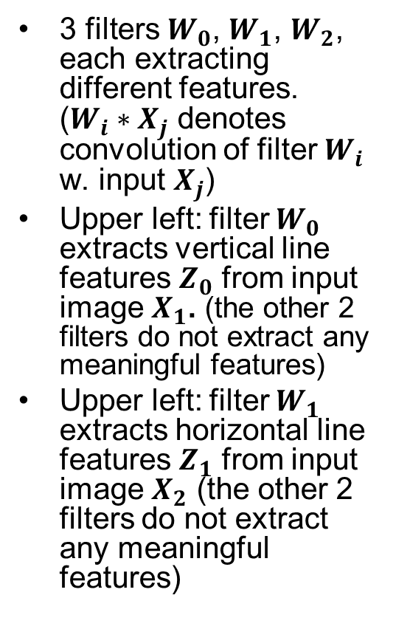
Example: 3 Filters
3 filters $W_{0}$, $W_{1}$, $W_{2}$, each extracting different features. ($W_{i}∗X_{j}$ denotes convolution of filter $W_{i}$ w. input $X_{j}$)
Upper left: filter $W_{0}$ extracts vertical line features $Z_{0}$ from input image $X_{1}$. (the other 2 filters do not extract any meaningful features)
Upper left: filter $W_{1}$ extracts horizontal line features $Z_{1}$ from input image $X_{2}$ (the other 2 filters do not extract any meaningful features)

Slide 16
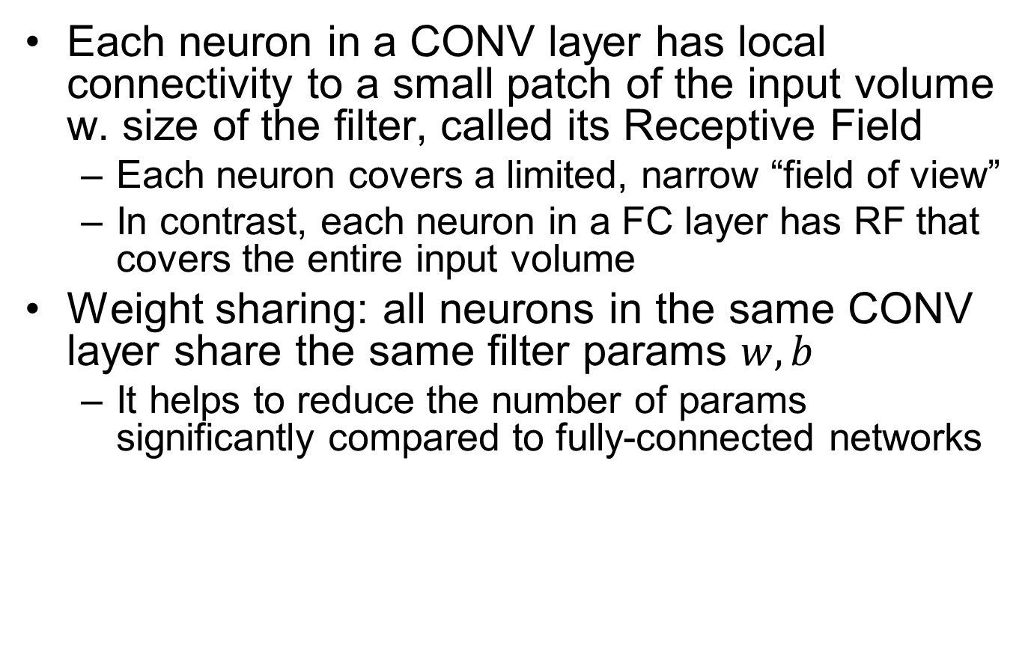
Receptive Field and Weight Sharing
Each neuron in a CONV layer has local connectivity to a small patch of the input volume w. size of the filter, called its Receptive Field
Each neuron covers a limited, narrow “field of view”
In contrast, each neuron in a FC layer has RF that covers the entire input volume
Weight sharing: all neurons in the same CONV layer share the same filter params $w,b$
It helps to reduce the number of params significantly compared to fully-connected networks

Slide 17
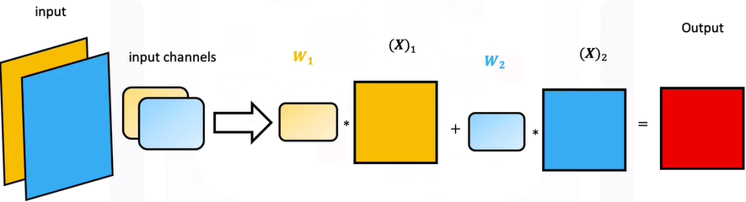
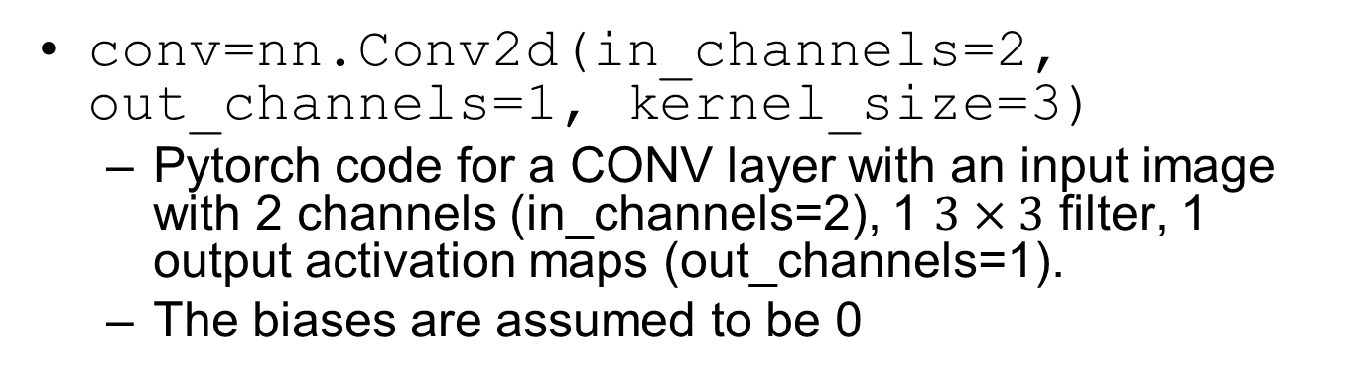
Convolution Example 1
conv=nn.Conv2d(in_channels=2, out_channels=1, kernel_size=3)
Pytorch code for a CONV layer with an input image with 2 channels (in_channels=2), 1 $3×3$ filter, 1 output activation maps (out_channels=1).
The biases are assumed to be 0
input
1 filter/kernel
output
https://www.coursera.org/learn/deep-neural-networks-with-pytorch/lecture/1rUTu/9-3-multiple-input-and-output-channels

Slide 18
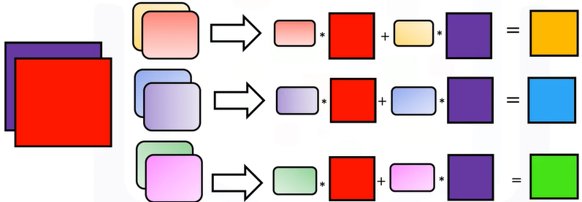
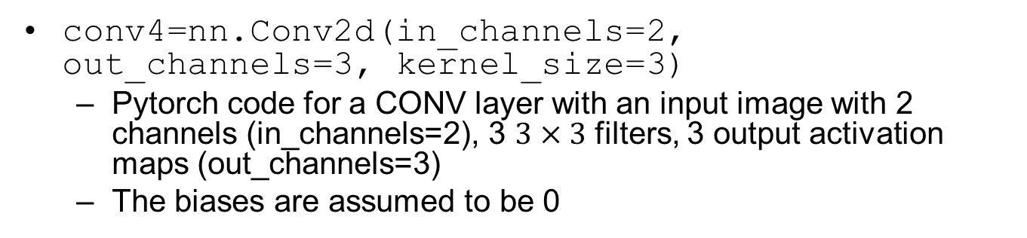
Convolution Example 2
conv4=nn.Conv2d(in_channels=2, out_channels=3, kernel_size=3)
Pytorch code for a CONV layer with an input image with 2 channels (in_channels=2), 3 $3×3$ filters, 3 output activation maps (out_channels=3)
The biases are assumed to be 0
input
3 filters/kernels
output

Slide 19
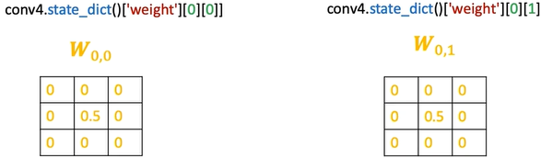
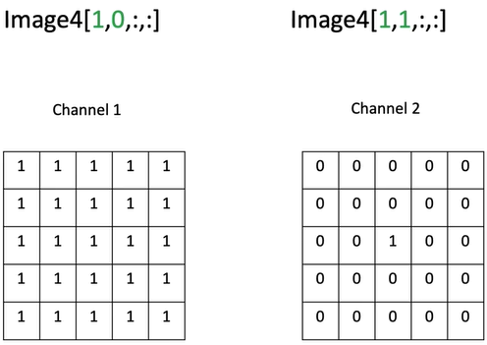
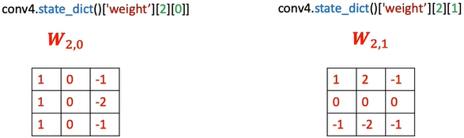
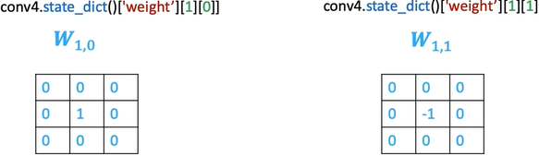
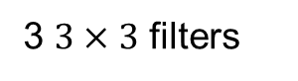
Convolution Example 2: Filters and Input Image
3 $3×3$ filters
input image with 2 channels

Slide 20
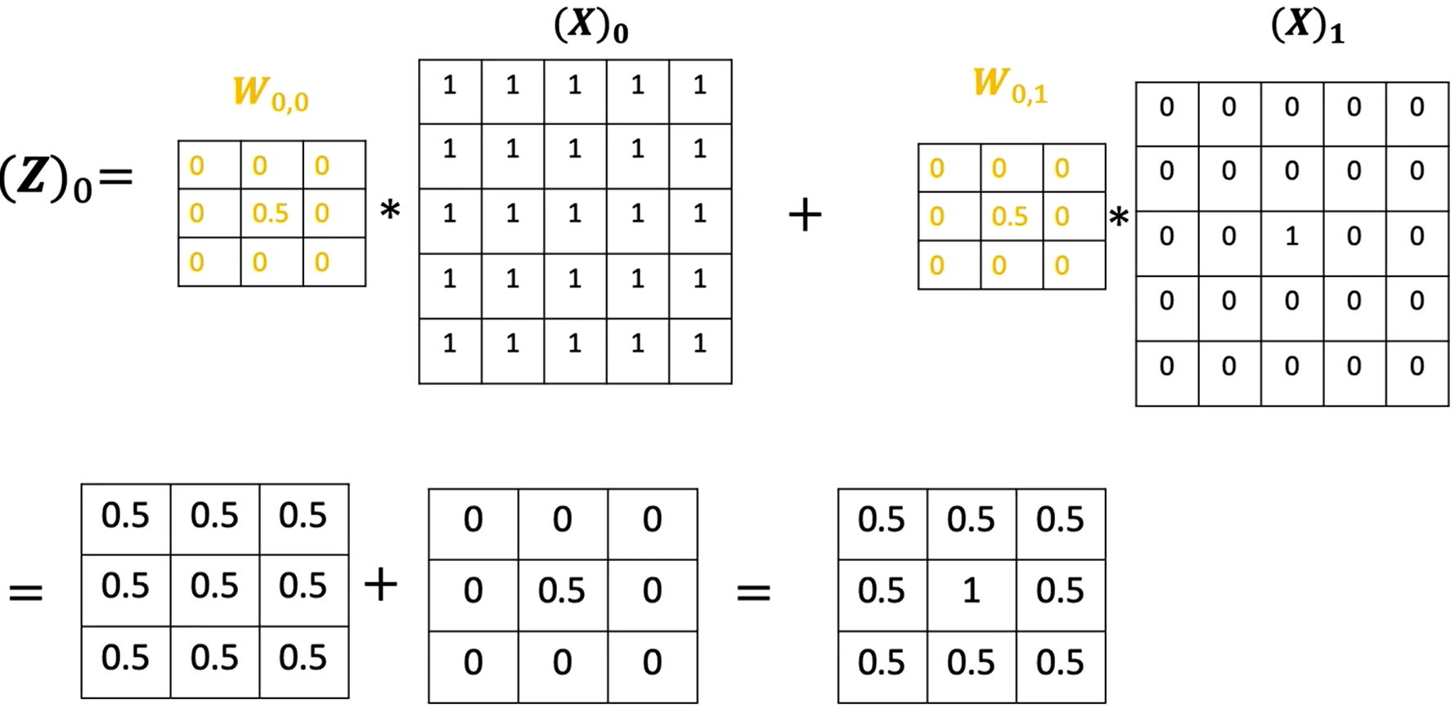
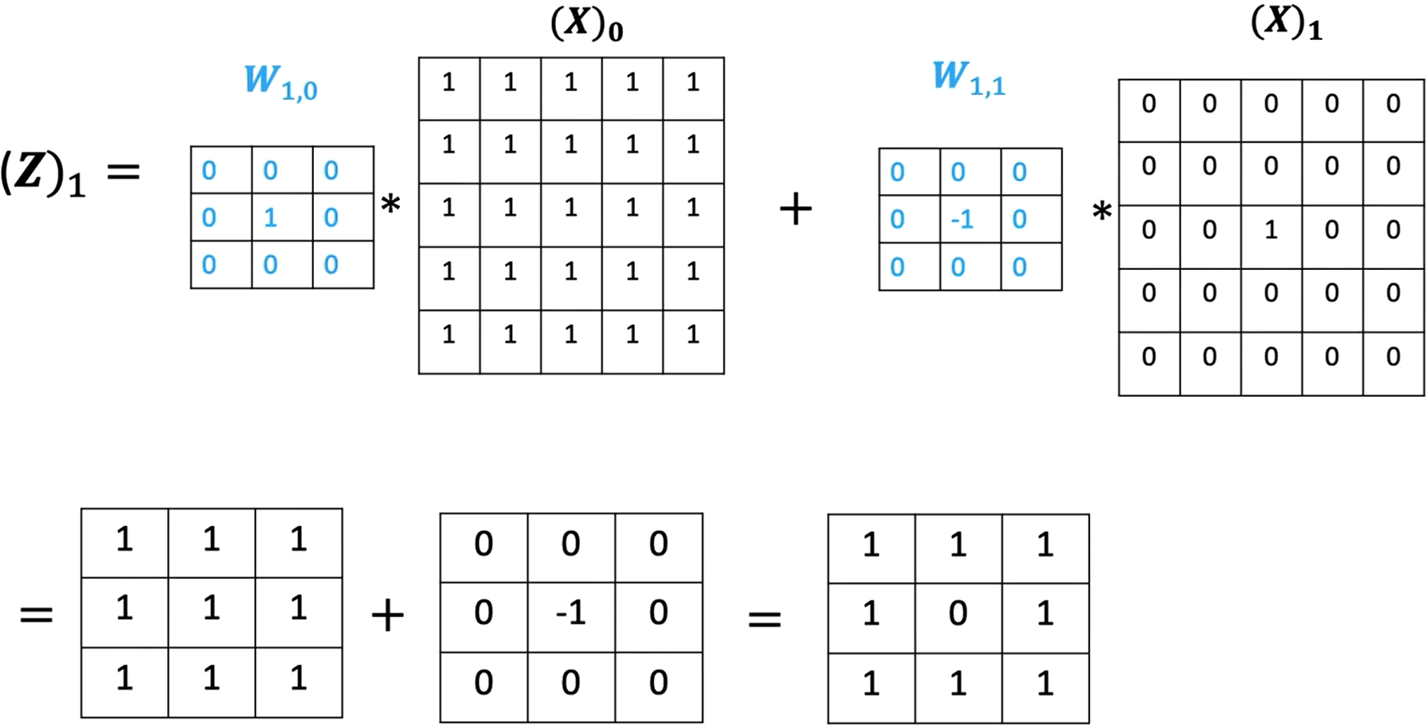
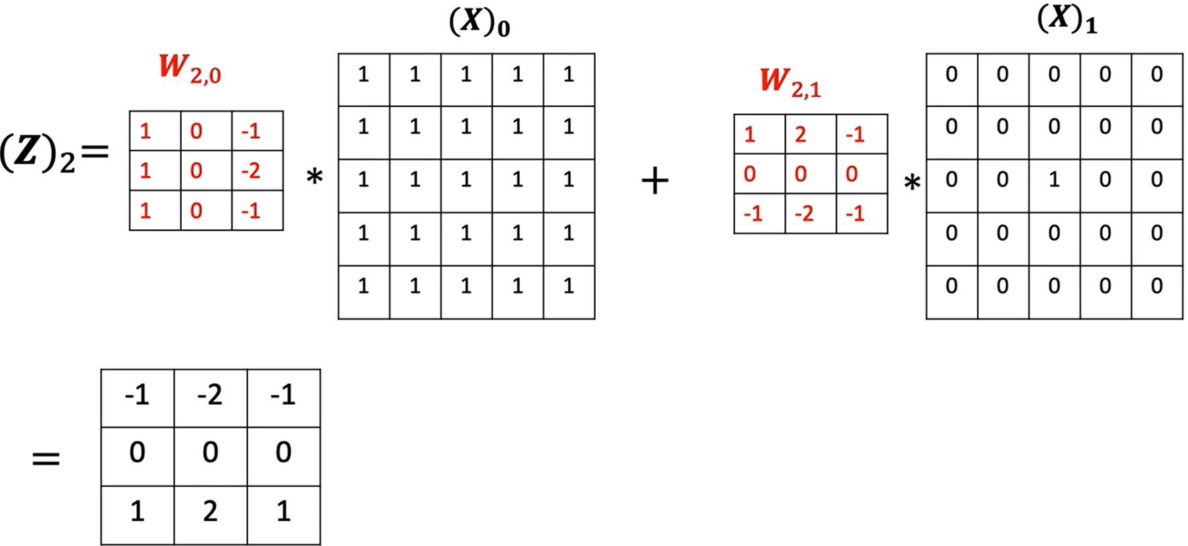
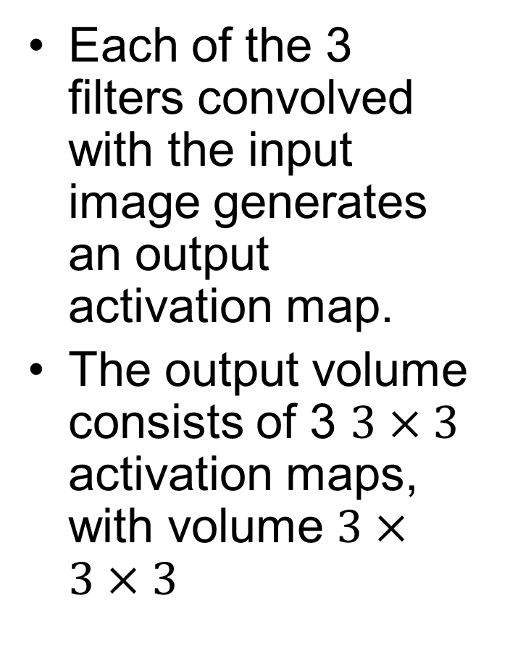
Convolution Example 2: Output
Each of the 3 filters convolved with the input image generates an output activation map.
The output volume consists of 3 $3×3$ activation maps, with volume $3×3×3$

Slide 21
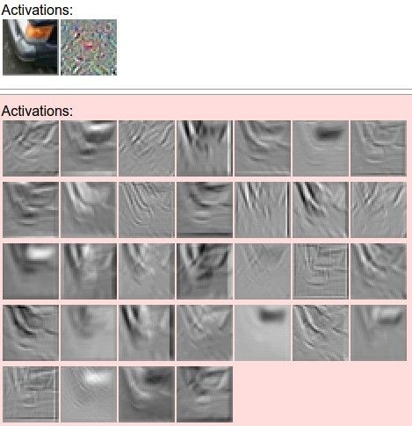
Filters and Activation Maps Example
filters
one filter =>
one activation map
example 5x5 filters
(32 total)
Section 6 - 21

Slide 22
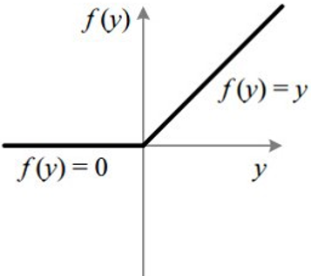
Typical CNN Architecture
Multiple layers, each consisting of CONV, POOL and non-linear activation functions (e.g., ReLU), are stacked into a deep network
Many variants possible, e.g., multiple CONV layers can be stacked without POOL and activation functions in-between
32
28
24
….
CONV,
POOL, ReLU
e.g. 6 5x5x3 filters
CONV,
POOL, ReLU
e.g. 10 5x5x6 filters
CONV,
POOL, ReLU
32
28
24
3
6
10
ReLU Activation Function

Slide 23

Feature Hierarchy
Multiple hidden layers can to extract a hierarchy of increasingly-abstract features layer-by-layer, until the last layer produces a classification result
Notes:
Fig shows hierarchy of features extracted by different layers of the CNN

Slide 24
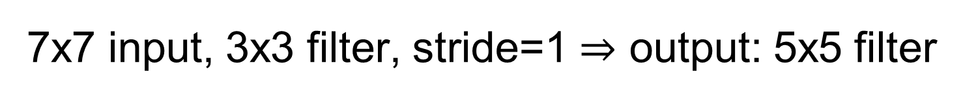
7x7 input, 3x3 filter, stride=1 $⇒$ output: 5x5 filter

Slide 25
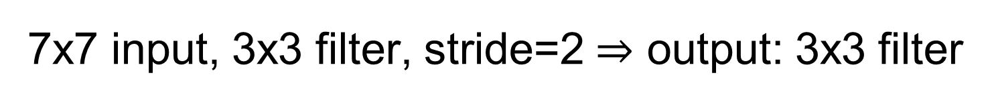
7x7 input, 3x3 filter, stride=2 $⇒$ output: 3x3 filter

Slide 26
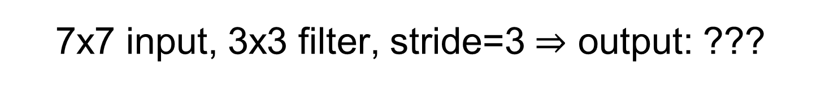
7x7 input, 3x3 filter, stride=3 $⇒$ output: ???
The rightmost and bottom columns are not processed!

Slide 27
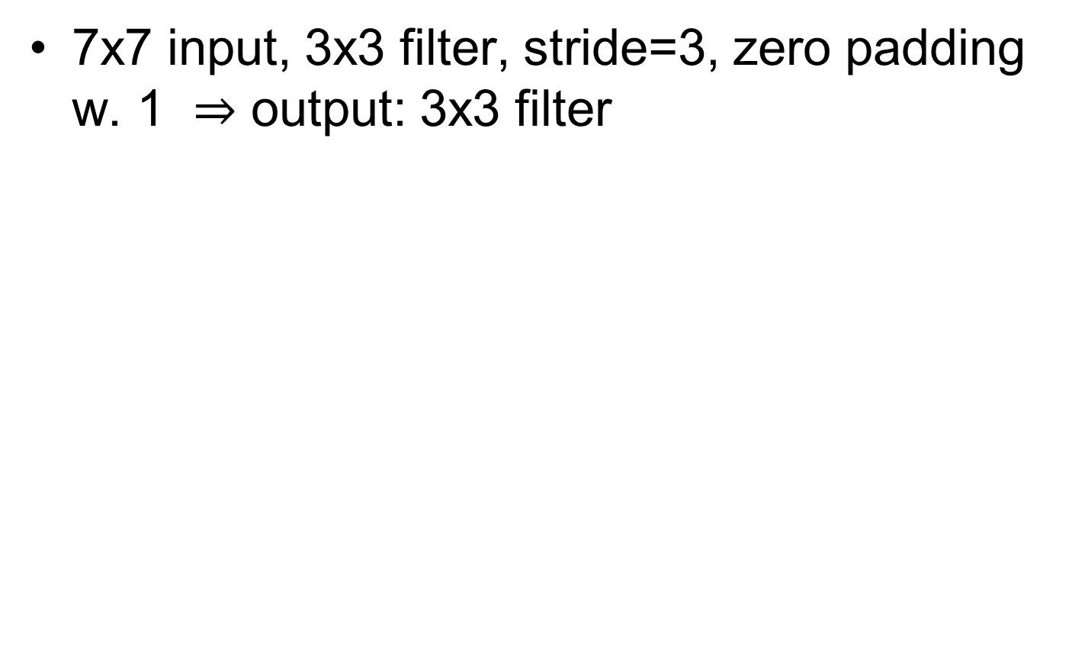
Solution: Add Padding
7x7 input, 3x3 filter, stride=3, zero padding w. 1 $⇒$ output: 3x3 filter
0 | 0 | 0 | 0 | 0 | 0 | 0 | 0 | 0
0
0
0
0
0 | 0 | 0 | 0 | 0 | 0 | 0 | 0 | 0
0
0
0
0
0 | 0 | 0 | 0 | 0 | 0 | 0 | 0 | 0
0
0
0
0

Slide 28
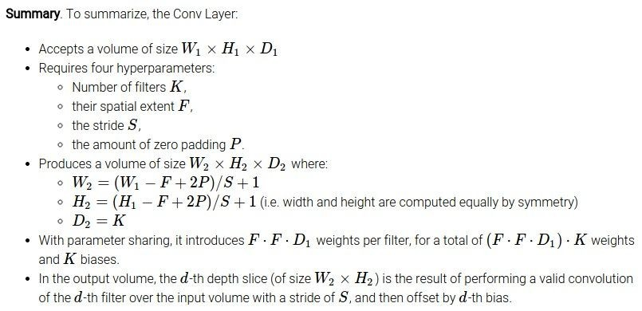
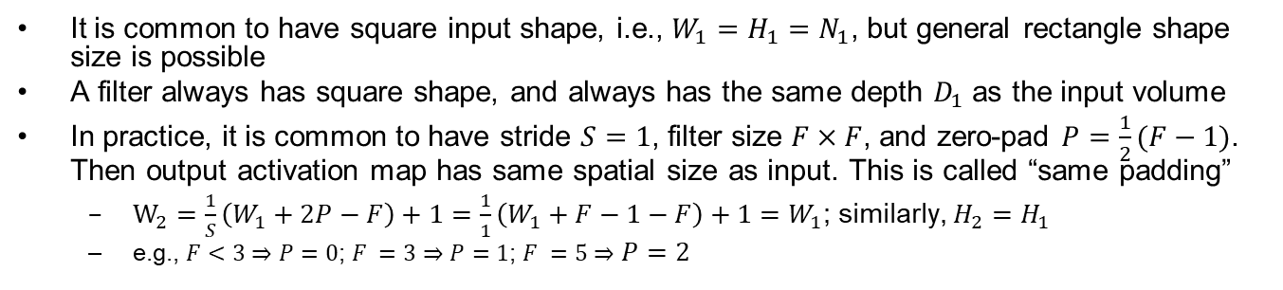
Computation of CONV Layer Sizes
Common settings:
K = (powers of 2, e.g. 32, 64, 128, 512)
- F = 3, S = 1, P = 1
- F = 5, S = 1, P = 2
- F = 1, S = 1, P = 0
It is common to have square input shape, i.e., $W_{1}=H_{1}=N_{1}$, but general rectangle shape size is possible
A filter always has square shape, and always has the same depth $D_{1}$ as the input volume
In practice, it is common to have stride $S=1$, filter size $F×F$, and zero-pad $P=\frac{1}{2}(F−1)$. Then output activation map has same spatial size as input. This is called “same padding”
$W_{2}=\frac{1}{S}\left(W_{1}+2P−F\right)+1=\frac{1}{1}\left(W_{1}+F−1−F\right)+1=W_{1}$; similarly, $H_{2}=H_{1}$
e.g., $F<3⇒P=0$; $F =3⇒P=1$; $F =5⇒P=2$

Slide 29

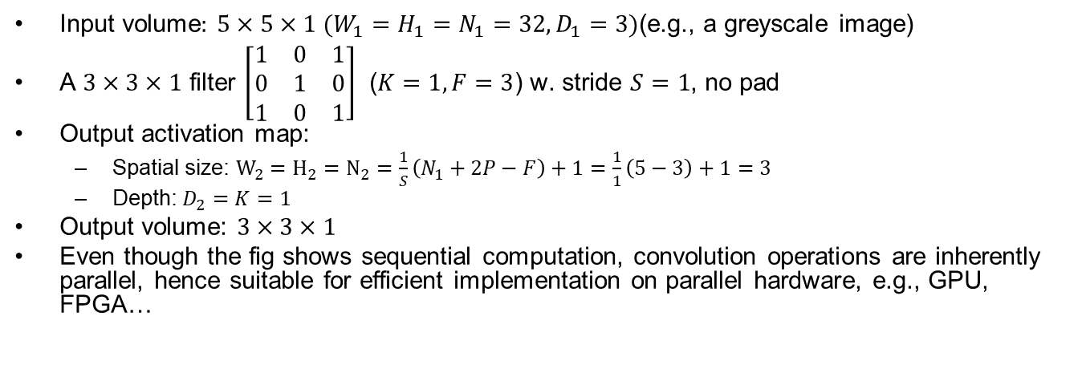
CONV Example 1: No Pad
Input volume$:$ $5×5×1$ $(W_{1}=H_{1}=N_{1}=32,D_{1}=3)$(e.g., a greyscale image)
A $3×3×1$ filter $\left[\begin{matrix}1 & 0 & 1 \\ 0 & 1 & 0 \\ 1 & 0 & 1\end{matrix}\right]$ ($K=1,F=3$) w. stride $S=1$, no pad
Output activation map:
Spatial size: $W_{2}=H_{2}=N_{2}=\frac{1}{S}\left(N_{1}+2P−F\right)+1=\frac{1}{1}\left(5−3\right)+1=3$
Depth: $D_{2}=K=1$
Output volume: $3×3×1$
Even though the fig shows sequential computation, convolution operations are inherently parallel, hence suitable for efficient implementation on parallel hardware, e.g., GPU, FPGA…

Slide 30
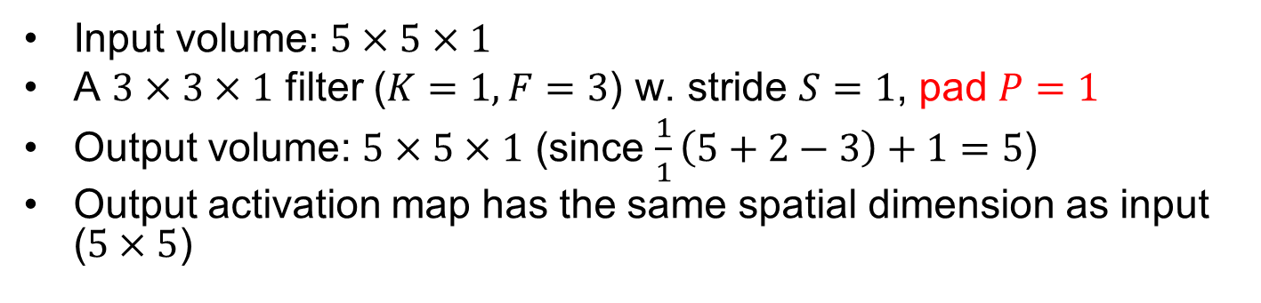
CONV Example 2: Same Padding
Input volume$:$ $5×5×1$
A $3×3×1$ filter ($K=1,F=3$) w. stride $S=1$, pad $P=1$
Output volume: $5×5×1$ (since $\frac{1}{1}\left(5+2−3\right)+1=5$)
Output activation map has the same spatial dimension as input ($5×5$)

Slide 31
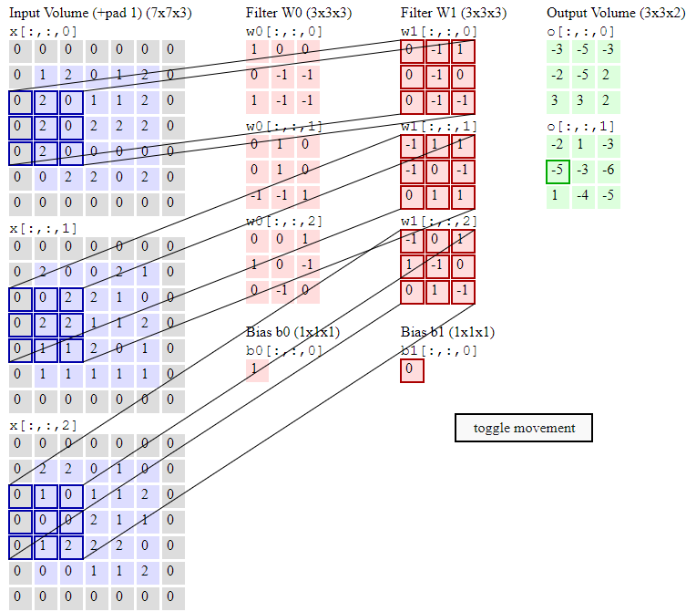

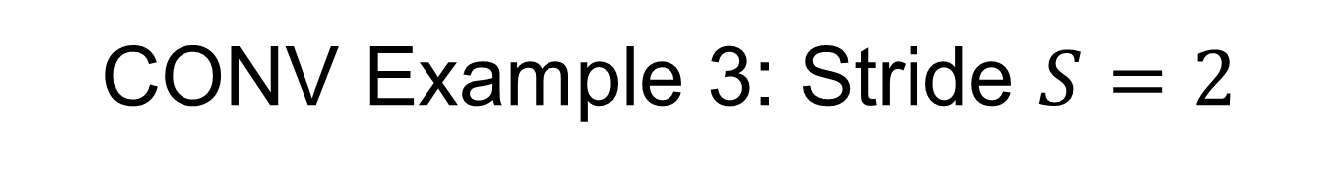
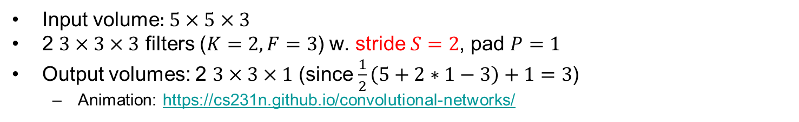
CONV Example 3: Stride $S=2$
Input volume$:$ $5×5×3$
2 $3×3×3$ filters ($K=2,F=3$) w. stride $S=2$, pad $P=1$
Output volumes: 2 $3×3×1$ (since $\frac{1}{2}\left(5+2∗1−3\right)+1=3$)
Animation: https://cs231n.github.io/convolutional-networks/

Slide 32


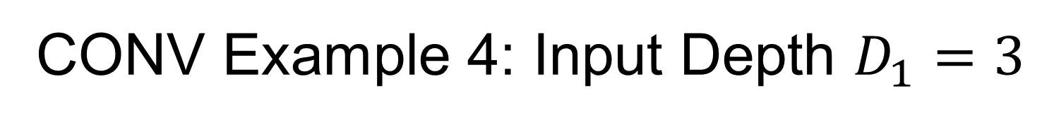
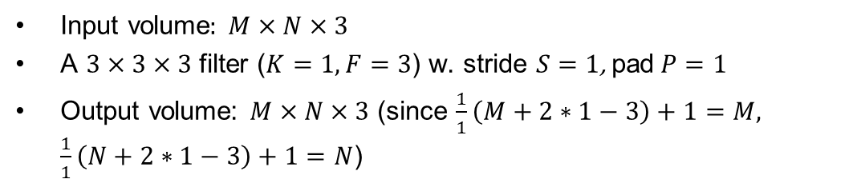
CONV Example 4: Input Depth $D_{1}=3$
Movement of the filter
Input volume$:$ $M×N×3$
A $3×3×3$ filter ($K=1,F=3$) w. stride $S=1$, pad$P=1$
Output volume: $M×N×3$ (since $\frac{1}{1}\left(M+2∗1−3\right)+1=M, \frac{1}{1}\left(N+2∗1−3\right)+1=N$)
https://towardsdatascience.com/a-comprehensive-guide-to-convolutional-neural-networks-the-eli5-way-3bd2b1164a53
Notes:
Convolution of $3×3×3$ filter on a input volume w. stride $S=1$, padding $P=1$, produces a $M×N×3$ output volume (since $\frac{1}{1}\left(M+2∗1−3\right)+1=M,\frac{1}{1}\left(N+2∗1−3\right)+1=N$)

Slide 33


CONV Example 5: Multiple Filters $K=10$
Input volume$:$ $32×32×3$ $(W_{1}=H_{1}=N_{1}=32,D_{1}=3)$
$10 5×5×3$ filters ($K=10,F=5$) w. stride $S=1$, no pad ($P=0$)
Each output activation map:
Spatial size: $W_{2}=H_{2}=N_{2}=\frac{1}{S}\left(N_{1}+2P−F\right)+1=\frac{1}{1}\left(32−5\right)+1=28$
Depth: $D_{2}=K=10$
Output volume: $28×28×10$
No. params (weights and biases) in this layer: each filter has $5∗5∗3+1=76$ params, so 10 filters add up to $76∗10=760$ params
32
32
28
28
…
(10 neurons)
32
32
28
28
3
3
10
Notes:
(32+2*2-5)/1+1 = 32 spatially, so
32x32x10

Slide 34


CONV Example 5: Neuron View
One activation map is a $28×28$ sheet of neuron outputs.
With 10 filters, the CONV layer consists of neurons arranged in a 3D grid ($28×28×10$).
For each $5×5$ patch of the input, there are 10 different neurons all looking at it, each extracting different features
32
32
28
28
…
(10 neurons)
32
32
28
28
3
3
10

Slide 35


CONV Example 6: Pad$P=2$
Input volume$:$ $32×32×3$ $(W_{1}=H_{1}=N_{1}=32,D_{1}=3)$
$10 5×5×3$ filters ($K=10,F=5$) w. stride $S=1$, pad$P=2$
Each activation map:
Spatial size: $W_{2}=H_{2}=N_{2}=\frac{1}{S}\left(N_{1}+2P−F\right)+1=\frac{1}{1}\left(32+2∗2−5\right)+1=32$
Depth: $D_{2}=K=10$
Output volume:$32×32×10$
No. params: each filter has $5∗5∗3+1=76$ params, so 10 filters add up to $76∗10=760$ params
Notes:
(32+2*2-5)/1+1 = 32 spatially, so
32x32x10

Slide 36


CONV Example 7: $1×1$ Filter
Input volume$:$ $56×56×64$ $(W_{1}=H_{1}=N_{1}=56, D_{1}=64)$
$32 1×1×64$ filters ($K=32,F=1$) w. stride $S=1$, no pad
Each activation map:
Spatial size: $W_{2}=H_{2}=N_{2}=\frac{1}{S}\left(N_{1}+2P−F\right)+1=\frac{1}{1}\left(56−1\right)+1=56$
Depth: $D_{2}=K=32$
Output volume:$56×56×32$
No. params: each filter has $1∗1∗64+1=65$ params, so 32 filters add up to $65∗32=2080$ params
A $1×1$ filter performs “mixing” of the 64 input channels, then applies a non-linear activation function
1x1 Conv
w. 32 filters
56
56
(each filter has size 1x1x64, and performs a 64-dimensional dot product)
56
56
64
32
Notes:
(32+2*2-5)/1+1 = 32 spatially, so
32x32x10

Slide 37


Transposed Convolution
The output of Transposed Convolution has larger spatial size than the input, used for up-sampling
Right fig shows fractionally-strided convolution, where zeros are inserted between input elements, which makes the kernel move at a slower pace than with unit strides
Applications include segmentation, auto-encoders, etc.

Slide 38

Dilated Convolution
Zeros are inserted between filter elements to increase receptive field size without increasing # params.

Slide 39




Spatial Separable Convolution
Helps reduce computation load, e.g., total # arithmetic operations:
Upper right: the Sobel kernel for detecting edges can be spatially separated (Not all kernels can be spatially separated)
Middle right: Regular convolution of a $3×3$ filter with $5×5$ input: $3∗3∗3∗3=81$ ($3∗3$ operations for each of $3∗3$ positions)
Bottom: Spatial Separable Convolution of a $3×1$ filter and $1×3$ filter with $5×5$ input: $3∗1∗5∗3+3∗1∗3∗3=72$ ($3∗1$ operations for each of $5∗3$ positions for 1st convolution, plus $3∗1$ operations for each of $3∗3$ positions for 2nd convolution)
https://towardsdatascience.com/a-basic-introduction-to-separable-convolutions-b99ec3102728

Slide 40



Depthwise Separable Convolution: Review of Regular Convolution
Upper right: Regular convolution of a $3×3×3$ filter with $7×7×3$ input: $3∗3∗3∗5∗5=675$ ($3∗3∗3$ operations for each of $5∗5$ positions)
Lower right: Regular convolution of 128 $3×3×3$ filters with $7×7×3$ input: $128∗675=86400$ operations ($675$ operations for each of $128$ filters)

Slide 41


Depthwise Separable Convolution
Step 1 Depthwise CONV: use 3 $3×3×1$ filters, convolve each with 1 channel of the input to generate a $5×5×1$ output, then stack them together to get $5×5×3$ output volume
# arithmetic operations: $3∗3∗3∗1∗5∗5=675$ ($3∗3∗1$ operations for each of $5∗5$ positions, for each of $3$ filters)
Step 2 Pointwise CONV: use 128 $1×1×3$ filters, convolve each with 3 channels of its input to generate $5×5×128$ output volume
# arithmetic operations: $128∗1∗1∗3∗5∗5=9600$ ($1∗1∗3$ operations for each of $5∗5$ positions, for each of 128 filters)
Total # arithmetic operations: $675+9600=10275$
Only 12% of $86400$ operations for regular convolution
(Optional) Depthwise Separable Convolution - A FASTER CONVOLUTION!
https://www.youtube.com/watch?v=T7o3xvJLuHk
Notes:
https://mp.weixin.qq.com/s/MIO-uwALL7_8cuFNfjgp5g

Slide 42

3D Convolution
3D filter slides along all 3 axes (width, height, depth). Very computation intensive
Useful for 3D images such as medical CT/MRI images, or Point Clouds from Lidar

Slide 43

Converting Convolution to Matrix Multiplication
Facilitates parallel HW implementation, since parallel HW (GPU, FPGA…) can handle matrix multiplication efficiently, at the expense of increased memory size for storing the weights (the biases are not shown in fig)

Slide 44

Quiz
What does a CONV layer w. filter volume $K×K×D_{1}$ equal to its input volume $N×N×D_{1}$, i.e., $K=D$, w. stride $S=1$ and no pad look like?
ANS: It consists of a single neuron (since $F=N_{1}⇒$ $N_{2}=\frac{1}{S}\left(N_{1}+2P−F\right)+1=1$)
Notes:
Input volume$:$ $7×7×3$ $(W_{1}=H_{1}=N_{1}=7,D_{1}=1)$
A$3×3×3$ filter ($K=1,F=3$) w. stride $S=3$, pad$P=1$. What is the output volume and No. params?
ANS: Each output activation map:
Spatial size: $W_{2}=H_{2}=N_{2}=\frac{1}{S}\left(N_{1}+2P−F\right)+1=\frac{1}{3}\left(7+2∗1−3\right)+1=3$
Depth: $D_{2}=K=1$
Output volume: $3×3×1$
No. params: one filter w. $3∗3∗3+1=28$ params

Slide 45
Outline
CNN Convolution layers
Pooling and fully connected layers
CNN case studies
CNN on Embedded Systems
RNNs
Notes:
Safety plan
The safety plan gives an overview of how you are going to achieve a safe system. A few of the major elements include:
what system is under consideration
the goal of the project
what steps will be taken to ensure safety
the roles and personnel involved in the project
the project timeline

Slide 46

Pooling and Fully-Connected Layers

Slide 47


Pooling (Sub-Sampling) Layer
A pooling filter has depth 1, and operates over each activation map independently, hence the input volume and output volume always have the same depth $D_{1}$(unlike a CONV filter, which always has the same depth $D_{1}$ as the input volume, and output volume has depth $D_{2}=K$, the No. filters)
Common settings: $F=3, S=2$, or $F=3, S=2$
Example: pooling w. a $2×2$ filter w. stride $S=2$, no pad
Output volume: $\frac{W_{1}}{2}×\frac{H_{1}}{2}×D_{1}$(since $\frac{1}{2}\left(W_{1}−2\right)+1=\frac{W_{1}}{2},\frac{1}{2}\left(H_{1}−2\right)+1=\frac{H_{1}}{2}$)

Slide 48


Max Pooling w. Examples
Max pooling: take the max element among the $F∗F$ elements in each $F×F$ patch of each input activation map to reduce its dimension
Alternative: average pooling is less commonly used
1 | 1 | 2 | 4
5 | 6 | 7 | 8
3 | 2 | 1 | 0
1 | 2 | 3 | 4
max pool w. 2x2
filter and stride 2
6 | 8
3 | 4
Notes:
Operates over each activation map to reduce its dimension independently
e.g. each activation map is reduced from 224x224 to 112x112
always has the same depth $D_{1}$ as the input volume

Slide 49


Overlapping Pooling
Input volume: $N×N×D_{1}$
A $3×3$ filter w. stride $S=1$, no pad
Output volume: $(N−2)×(N−2)×D_{1}$(since $\frac{1}{1}\left(N−3\right)+1=N−2$)
(This setting is uncommon. It is more common to have $F=3, S=2$ for overlapping pooling)
Notes:
$$F=3, S=2$$

Slide 50



FC Layer
Contains neurons that connect to the entire input volume w. no weight sharing
No. params for FC layer of size $N_{out}$ connected to input layer of size $N_{in}$ is $(N_{in}+1)∗N_{out}$

Slide 51




No. Params in Each Layer
 | CONV | POOL | FC
Input size | $$N_{1}×N_{1}×D_{1}$$ | $$N_{1}×N_{1}×D_{1}$$ | $$N_{in}$$
Output Size | $$N_{2}×N_{2}×K$$ | $$N_{2}×N_{2}×D_{1}$$ | $$N_{out}$$
No. params | $$\left(F∗F∗D_{1}+1\right)∗K$$ | $$0$$ | $$\left(N_{in}+1\right){∗N}_{out}$$
https://stanford.edu/~shervine/teaching/cs-230/cheatsheet-convolutional-neural-networks
Notes:
(Here $C$ denotes the depth $D$, also called number of Channels)
In practice, FC layers contribute the most number of parameters (well over 90% for large CNNs)

Slide 52
Outline
CNN Convolution layers
Pooling and fully connected layers
CNN case studies
CNN on Embedded Systems
RNNs
Notes:
Safety plan
The safety plan gives an overview of how you are going to achieve a safe system. A few of the major elements include:
what system is under consideration
the goal of the project
what steps will be taken to ensure safety
the roles and personnel involved in the project
the project timeline

Slide 53


Case Study: LeNet-5 [LeCun et al. 1998]
Architecture is [CONV-POOL-CONV-POOL-CONV-FC-FC]
Input image: $32×32×1$(grey-scale images of hand-written digits w. size $32×32$ pixels)
Conv filters $5×5×1$ w. stride 1; Subsampling (Pooling) layers were $2×2$ w. stride $2$
Conv layer C1 maps from input volume $32×32×1$ to 6 feature maps w. volume $28×28×6$ (since $\frac{1}{1}(32−5)+1=28$)
Subsampling layer S2 maps from input volume $28×28×1$ to 6 feature maps w. volume $14×14×6$ (since $\frac{1}{2}(28−2)+1=14$)
Conv layer C3 maps from input volume $14×14×6$ to 16 feature maps w. volume $10×10×16$ (since $\frac{1}{1}(14−5)+1=10$)
Subsampling layer S4 maps from input volume $10×10×16$ to 16 feature maps w. volume $5×5×16$ (since $\frac{1}{2}(10−2)+1=5$)
Conv layer C5 maps from input volume $5×5×16$ to 120 feature maps w. volume $1×1×120$ (since $\frac{1}{1}(5−5)+1=1$)
Fig shows “Full Connection” before C5, but it is actually a Conv layer w. filter size equal to input size, followed by a “flatten” layer to turn it from $1×1×120$ to a linear array of $120$ neurons
Subsequent FC layers F6 and Output have 84 and 10 neurons, respectively

Slide 54


LeNet-5 Summary
Layer | Layer Type | No. Filters | Filter Size | Layer Size | No. params
Input | Image | - | - | $$32×32×1$$ | -
C1 | Conv | $$6$$ | $$5×5$$ | $$28×28×6$$ | $$156$$
S2 | Subsamp | $$6$$ | $$2×2$$ | $$14×14×6$$ | $$0$$
C3 | Conv | $$16$$ | $$5×5$$ | $$10×10×16$$ | $$2416$$
S4 | Subsamp | $$16$$ | $$2×2$$ | $$5×5×16$$ | $$0$$
C5 | Conv+ | $$120$$ | $$5×5$$ | $$1×1×120$$ | $$48120$$
 | Flatten | - | $$−$$ | $$120$$ | $$0$$
S6 | FC | - | $$−$$ | $$84$$ | $$10164$$
Output | FC |  |  | $$10$$ | $$850$$
C1: No. params: $\left(F^{2}D_{1}+1\right)∗K=\left(5∗5∗1+1\right)∗6=156$
C3: No. params: $\left(5∗5∗6+1\right)∗16=2416$
C5: No. params: $\left(5∗5∗16+1\right)∗120=48120$
S6: No. params: $\left(120+1\right)∗84=10164$
Output: No. params: $\left(N_{in}+1\right)∗N_{out}=\left(84+1\right)∗10=850$
Total No. params: $61706$

Slide 55


Case Study: AlexNet [Krizhevsky et al. 2012]
[227x227x3] INPUT
[55x55x96] CONV1: 96 11x11 filters w. stride 4, pad 0 [27x27x96] MAX POOL1: 3x3 filters w. stride 2 [27x27x96] NORM1: Normalization layer
[27x27x256] CONV2: 256 5x5 filters w. stride 1, pad 2 [13x13x256] MAX POOL2: 3x3 filters at stride 2 [13x13x256] NORM2: Normalization layer [13x13x384] CONV3: 384 3x3 filters w. stride 1, pad 1 [13x13x384] CONV4: 384 3x3 filters w. stride 1, pad 1 [13x13x256] CONV5: 256 3x3 filters w. stride 1, pad 1 [6x6x256] MAX POOL3: 3x3 filters w. stride 2
[4096] FC6: 4096 neurons
[4096] FC7: 4096 neurons
[1000] FC8: 1000 neurons (class scores)
ImageNet top 5 error: 15.4%
Input image: $227×227×3$
1st layer (CONV1): $96 11×11$ filters w. stride $S=4$, w. ReLU activation function
Output volume: $55×55×96$ (since $\frac{1}{4}\left(227−11\right)+1=55$)
No. params: $\left(11∗11∗3+1\right)∗96=35K$
2nd layer (POOL1): $3×3$ filters w. stride $S=2$ (overlapping)
Output volume: $27×27×96$ (since $\frac{1}{2}\left(55−3\right)+1=27$)
No. params: $0$
…
Total No. params: 60M

Slide 56


Case Study: VGGNet [Simonyan and Zisserman, 2014]
We show the best performing variant VGG-16

Slide 57

VGG-16 Details
VGG-16 has 16 weight layers, not including POOL layers w. 0 weight
Input image: $224×224×3$
1st and 2nd CONV layers: $64 3×3$ filters w. stride $S=1$, pad $P=1$
Output volume: $224×224×64$ (since $\frac{1}{1}\left(224+2∗1−3\right)+1=224$)
3rd POOL layer: $2×2$ filters w. stride $S=2$
Output volume: $112×112×64$ (since $\frac{1}{2}\left(224−2\right)+1=112$)
4th and 5th CONV layers: $128 3×3$ filters w. stride $S=1$, pad $P=1$
Output volume: $112×112×128$ (since $\frac{1}{1}\left(112+2∗1−3\right)+1=112$)
6th POOL layer: $2×2$ filters w. stride $S=2$
Output volume: $56×56×128$ (since $\frac{1}{2}\left(112−2\right)+1=56$)
Total No. params: 60M
ImageNet top 5 error: 7.3%

Slide 58




Stacked $3×3$ CONV Layers
2 stacked $3×3$ CONV layers w. pad $P=1$ have the same effective receptive field as a $5×5$ CONV layer; 3 stacked $3×3$ CONV layers w. pad $P=1$ have RF of $7×7$; $L$ stacked $3×3$ CONV layers w. pad $P=1$ have RF of $1+2L$
Benefits:
Fewer params. Suppose all volumes have the same depth $D$, then a $7×7$ CONV layer has $\left(7∗7∗D+1\right)∗D≈49D^{2}$ params, while three stacked 3x3 CONV layers have only $\left(3∗3∗D+1\right)∗D∗3)≈27D^{2}$ params
Two layers of non-linear activation functions increases CNN depth, hence larger model capacity
https://zhuanlan.zhihu.com/p/79258431

Slide 59

VGGNet No. Params
Memory refers to memory size of activation maps
For ease of calculation, only the No. weights are counted, not the biases

Slide 60

VGGNet Variants
Best performing variant
VGG-16

Slide 61


Case Study: GoogLeNet [Szegedy et al., 2014]
ImageNet top 5 error: 6.7%
Inception module

Slide 62

GoogLeNet Size
Compared to AlexNet:
12x less params (only 5M, due to no FC layers), 2x more compute (due to more CONV layers)

Slide 63


Case Study: Residual Networks (ResNet) [He et al. 2015]
Based on VGG-19, adding more layers and skip connections
ImageNet top 5 error: 3.6%

Slide 64


ResNet Variants
Right fig shows 34-layer ResNet

Slide 65

ResNet Skip Connection
In a standard network, output from a given layer is $F\left(x\right)$
In ResNet w. the identity skip (or short-cut) connection, output from a given layer is $H\left(x\right)=F\left(x\right)+x$
If identify mapping is close to optimal, then weights can be small to capture minor differences only
Benefits:
Residual connections help in handling the vanishing gradient problem in very deep NNs
It is safe to train very deep NNs, because “unnecessary layers” can learn to be identity mapping and do no cause overfitting

Slide 66











Consider a 3-layer Network
Standard NN:
$x_{3}=f_{3}\left(f_{2}(f_{1}(x_{0}\right)))$
ResNet:
$x_{1}=f_{1}\left(x_{0}\right)+x_{0}$
$x_{2}=f_{2}\left(x_{1}\right)+x_{1}=f_{2}\left(f_{1}\left(x_{0}\right)+x_{0}\right)+f_{1}\left(x_{0}\right)+x_{0}$
$x_{3}=f_{3}\left(x_{2}\right)+x_{2}=f_{3}\left(f_{2}\left(f_{1}\left(x_{0}\right)+x_{0}\right)+f_{1}\left(x_{0}\right)+x_{0}\right)+f_{2}\left(f_{1}\left(x_{0}\right)+x_{0}\right)+f_{1}\left(x_{0}\right)+x_{0}$
Suppose $f2(x1)$ is a vector of very small values (layer 2 is “off”/skipped), then it looks like the input $x_{0}$ bypassed the second layer completely on its way to the output $x_{3}$
$$x_{0}$$
$$x_{1}$$
$$x_{2}$$
$$x_{3}$$
$$x_{0}$$
$$x_{1}$$
$$x_{2}$$
$$x_{3}$$

Slide 67


ResNet is Ensemble of Models
Every input $x_{0}$ to ResNet may activate a unique path to the output. Total number of possible paths is $2^{N}$, where $N$ is the total number of layers in the network, since each layer may be either “on” or “off” for a given input $x_{0}$
Compare w. a standard network, where there is only one single path for any input corresponding to all layers being “on”, and no layer is skipped
Consequences:
Resilience to layer deletion: deleting 1-3 layers in a large ResNet introduces only around 6-7% error
Shortening of effective paths: w. 152-layer ResNet, most paths are only 20-30 levels deep!
Notes:
At every single node, there are multiple paths, each of which may or may not contribute to the overall output. So

Slide 68



Deeper Nets have Better Performance

Slide 69

Case Study: Policy Network in AlphaGo
Input volume: [19x19x48]
CONV1: 192 5x5 filters, stride 1, pad 2
Output volume: [19x19x192] (since $\frac{1}{1}\left(19+2∗2−5\right)+1=19$)
CONV2..12: 192 3x3 filters, stride 1, pad 1
Output volume: [19x19x192] (since $\frac{1}{1}\left(19+2∗1−3\right)+1=19$)
CONV: 1 1x1 filter, stride 1, pad 0
Output volume: [19x19] (since $\frac{1}{1}\left(19−1\right)+1=19$)

Slide 70


Case Study: Stochastic Depth
For each minibatch of inputs, randomly skip some layers (replaced w. identity mapping)
Reduced network depth during training; full depth during inference
MB1
MB2
MB3

Slide 71
Layer Sizing Rules-of-Thumb
The input layer (that contains the image) should be divisible by 2 many times. Common numbers include 32 (e.g. CIFAR-10), 64, 96 (e.g. STL-10), or 224 (e.g. ImageNet), 384, and 512.
The CONV layers should use small filters (e.g. 3x3 or at most 5x5), stride S=1. The input volume should have “same padding”, i.e., the conv layer does not alter the spatial size of the input. For any F, pad P=(F−1)/2 preserves the input size, e.g., when F=3, P=1; when F=5, P=2. This means the CONV layers only transform the input volume depth-wise, but do not perform downsampling. (c.f. CONV Example 3 and VGGNet).
The POOL layers are in charge of downsampling the spatial dimensions of the input. The most common setting is to use max-pooling with 2x2 receptive fields (F=2), with stride of 2 (S=2). A less common setting is to use F=3, S=2. It is uncommon to see receptive field sizes for max pooling that are larger than 3, because the pooling is then too lossy and aggressive.
In some cases (especially in early layers), the amount of memory can build up very quickly with the rules of thumb presented above. For example, filtering a 224x224x3 image with three 3x3 CONV layers with 64 filters each and padding 1 would create 3 activation volumes, each with size 224x224x64. This amounts to a total of about 10 million activations, or 72MB of memory (per image, for both activations and gradients). Since GPUs are often bottlenecked by memory, it may be necessary to compromise. In practice, make the compromise at only the first CONV layer that is looking at the input image. For example, AlexNet uses filter size of 11x11 and stride of 4 in the first CONV layer.
Notes:
That is, when F=3, then using P=1 will retain the original size of the input. When F=5, P=2.
Note that this discards 75% of the activations in an input volume (due to downsampling by 2 in both width and height). Only use bigger filter sizes (such as 7x7 or 11x11) on the very first conv layer that is looking at the input image.

Slide 72
Outline
CNN Convolution layers
Pooling and fully connected layers
CNN case studies
CNN on Embedded Systems
RNNs
Notes:
Safety plan
The safety plan gives an overview of how you are going to achieve a safe system. A few of the major elements include:
what system is under consideration
the goal of the project
what steps will be taken to ensure safety
the roles and personnel involved in the project
the project timeline

Slide 73
Memory Size Considerations
From the intermediate volume sizes:
These are the raw number of activations at every layer of the CNN, and also their gradients (of equal size). Usually, most of the activations are on the earlier CONV layers of a CNN. These are kept around because they are needed for backpropagation during training, but for inference, we can store only the current activations at the current layer and discarding the activations from previous layers.
From the parameter sizes:
These are the weights and biases, and their gradients during backpropagation, and also a step cache if the optimization is using momentum, Adagrad, or RMSProp. Therefore, the memory to store the parameter vector alone usually should be multiplied by a factor of at least 3 or so.
Misc memory, such as the image data batches, perhaps their augmented versions, etc.
Each number may need 4 Bytes storage space for floating point, 8 Bytes for double, or 1 Bytes or smaller for optimized fixed-point implementations.

Slide 74


CNN on Embedded Systems
Large CNN models are memory and computation intensive, even for inference tasks
Resource constrained embedded devices may have constraints in computational power and battery capacity, and cannot support large DNN inference tasks
More applicable to small mobile robots (e.g. drones) than fullsize AVs, which have powerful compute engines
Next, we consider running CNN models on resource-constrained platforms.
Notes:
Challenges:
Limited Computation Resource
Battery Constrained
Cooling Constrained

Slide 75

Weight Pruning
Reduce the number and/or bit-width of edge weights, especially for the FCLs, since weights of FCLs make up majority of the edge weight parameters of the entire CNN.

Slide 76







Device vs. Cloud
On-device execution
Computation workload may exceed computing or energy capacity.
Feasible for small models, or for devices w. power efficient hardware accelerators.
Computational offloading to the cloud
Network transmission costs time and energy.
Quality-of-Service Degradation due to network latencies and disruptions.
Solutions:
Make adaptive decisions based on network condition and device workload (e.g., w. Reinforcement Learning).
Place “Edge Servers” in close proximity to the devices, forming a multi-tier hierarchy of device-edge-cloud.
“DOG”
Device execution
“DOG”
Cloud execution

Slide 77


Example Scenario for Computational Offloading
Different DNNs offer varied compute/accuracy tradeoffs. Mobile-optimized vision DNNs, such as MobileNet and ShuffleNet, sacrifice accuracy to be faster and use less power, compared to the more accurate Mask R-CNN.
A small robot (e.g., a drone) may not have enough computing power to run Mask R-CNN. So it can either choose to run MobileNet or ShuffleNet locally, or send the images to the cloud, which runs Mask R-CNN and sends back the result.
Chinchali S, Sharma A, Harrison J, et al. Network offloading policies for cloud robotics: a learning-based approach[J]. arXiv preprint arXiv:1902.05703, 2019.

Slide 78







Collaborative Processing
Partition a DNN model layer-wise.
May be multiple layers w. the device-edge-cloud architecture.
Device executes early layers, and transmits intermediate feature maps to cloud, w. reduced network transmission compared to raw data (pixels).
“Early exit” is possible: if early layers can produce “good-enough” result, then skip cloud access.
Cloud
Device
“DOG”

Slide 79


CNN Layer Patterns
A typical CNN architecture looks like: INPUT->[[CONV->RELU]*N->POOL?]*M->[FC->RELU]*K->FC
where * indicates repetition, and POOL? indicates an optional pooling layer. $N≥0$ (usually $N≤3$), $M≥0$, $K≥0$ (and usually $K<3$)
Some common architectures:
INPUT->FC, implements a linear classifier. Here N = M = K = 0.
INPUT->CONV->RELU->FC
INPUT->[CONV->RELU->POOL]*2->FC->RELU->FC (fig below). There is a single CONV layer between every POOL layer.
INPUT->[CONV->RELU->CONV->RELU->POOL]*3->[FC->RELU]*2->FC There are two CONV layers stacked before every POOL layer. This is generally a good idea for larger and deeper networks, because multiple stacked CONV layers can develop more complex features of the input volume before the destructive pooling operation.
Notes:
[(CONV-RELU)*N-POOL?]*M-(FC-RELU)*K,SOFTMAX, where N is usually up to ~5, M is large, K <= 3
But recent architectures (ResNet/GoogLeNet) challenge this paradigm

Slide 80
CNN Summary
CNN is the dominant modeling paradigm for perception tasks in modern CV (detection, classification, tracking, segmentation)
ConvNets stack multiple CONV,POOL,FC layers
Recent trend: smaller filters, more layers, no POOL/FC layers (just CONV)

Slide 81
Outline
CNN Convolution layers
Pooling and fully connected layers
CNN case studies
CNN on Embedded Systems
RNNs
Notes:
Safety plan
The safety plan gives an overview of how you are going to achieve a safe system. A few of the major elements include:
what system is under consideration
the goal of the project
what steps will be taken to ensure safety
the roles and personnel involved in the project
the project timeline

Slide 82
Recurrent Neural Network (RNN)
An RNN has connections between nodes that form a directed graph along a temporal sequence. This allows it to process variable-length input sequences and take into account dynamic temporal behavior
e.g., To take into account temporal sequence of consecutive frames in a video clip, we can either stack together a fixed number of frames as input to a CNN, or we can use an RNN (combined w. CNN) to process any variable-length sequence of frames
FYI: Michael Phi, Illustrated Guide to Recurrent Neural Networks: Understanding the Intuition https://www.youtube.com/watch?v=LHXXI4-IEns
Notes:
Combining CNN and RNN results in Convolutional RNN.
RNN can process variable-length input sequence, suitable for tasks such as machine translation and speech recognition.

Slide 83

RNN Architecture Variants
Regular Feedforward NN
e.g. Image Captioning
image -> sequence of words
e.g. Sentiment Classification
sequence of words -> sentiment
e.g. Machine Translation
seq of words -> seq of words
e.g., video classification
on frame level

Slide 84




RNN Many-to-Many Architecture
RNN can process a sequence of inputs $x$ recurrently at every time step, w. the same activation function and parameters $f_{W}$
e.g. $h_{t}=\tanh{(W_{hh}h_{t−1}+W_{xh}x_{t})}, y_{t}=W_{hy}h_{t}$
$h_{t}$ can even be a large CNN (without the last classification layer)
new state at timestep $t$
old state input at
at $t−1$ timestep $t$
Activation function
w. params W
y
y_{t-1}
y_{t}
y_{t+1}
W_{hy}
W_{hy}
W_{hy}
Unroll
W_{hh}
W_{hh}
h
h_{t-1}
h_{t}
h_{t+1}
W_{xh}
W_{xh}
W_{xh}
x
x_{t-1}
x_{t}
x_{t+1}
Notes:
$h_{t}=f_{W}(h_{t−1},x_{t})$ https://en.wikipedia.org/wiki/Recurrent_neural_network

Slide 85

Example: Character-Level Language Model, Training Time
Task: predict the next char from current char sequence
Example training sequence: “hello” w. vocabulary: [h,e,l,o]
Input is one-hot encoding of each char
Hidden layer is learned embedding
Output layer is a probability vector w. size 4, denoting prob distribution of next char. (Fig shows the activation values before applying the SoftMax function for computing probabilities).
Notes:
At each timestep, we sample from the prob distribution of the output to generate the next input char. (Here we assume the char w. highest prob is always selected at each timestep, but it is possible to select the other choices)

Slide 86


Example: Character-Level Language Model, Inference Time
Initial input is char “h”
At each timestep, sample from the prob vector of the output $yt$ to generate the next input char
Here we assume the char w. highest prob is always selected as output at each timestep, i.e., “e”, “l”, “l” in sequence, but it is possible to select the other choices, e.g., “l”, “e”, “e”)
sample
sample
sample
Initial Input

Slide 87

Example: Image Captioning
CNN processes the input image and generates a feature vector as input to RNN
Recurrent Neural Network
Convolutional Neural Network

Slide 88



Image Captioning: Word-Level Language Model, Inference Time
The last 2 layers of the CNN for classification (FC-1000 and SoftMax) are not used, since we only need the extracted features from the layer FC-4096
At each timestep, sample from the prob vector of the output $yt$ to generate the next input word
y0
y1
y2
h0
h1
h2
sample
sample
sample
<END> token
=> finish.
x0
<STA RT>
straw
hat
<START>

Slide 89

Image Captioning Examples
Bottom row shows failure cases

Slide 90

RNN in AD
Combined with CNN, RNN can handle Non-Markovian behavior, i.e, the current action depends not just on the current observation (input image), but on a recent history of observations

Slide 91
RNN Summary
Training of RNNs requires back propagation through time, which may cause exploding or vanishing gradient problems
More sophisticated architectures are more practical
LSTM (Long Short-Term Memory Model) or GRU (Gated Recurrent Unit)
RNNs are most widely used in Natural Language Processing, but it is also useful for processing videos, w. applications in autonomous driving

